Slide 1









Collaboration for Aesthetic Sustainability

Slide 2

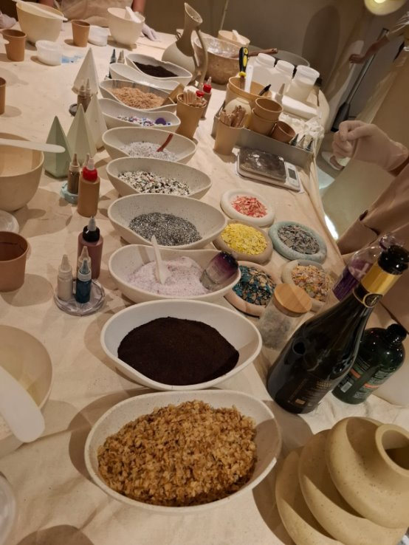
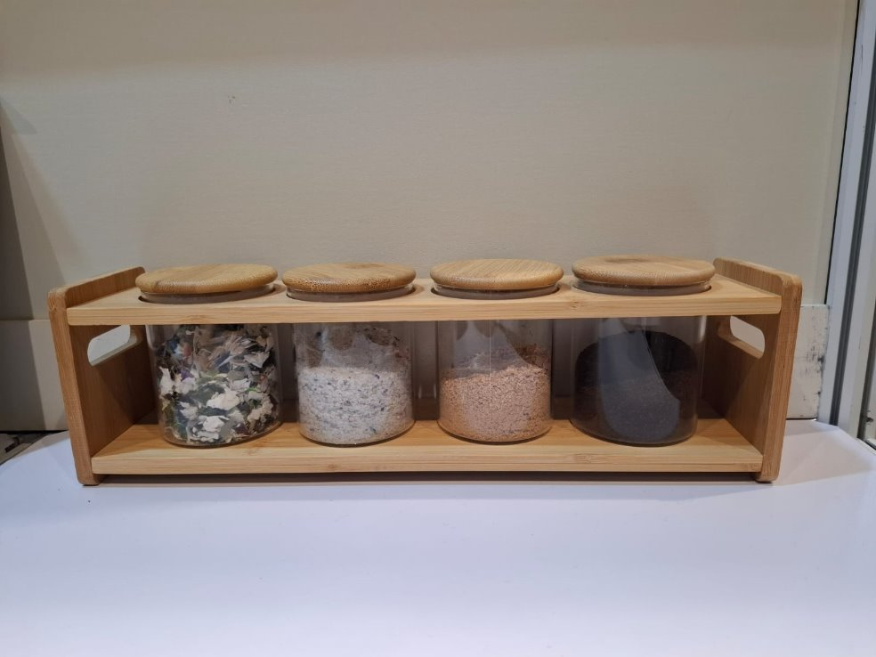
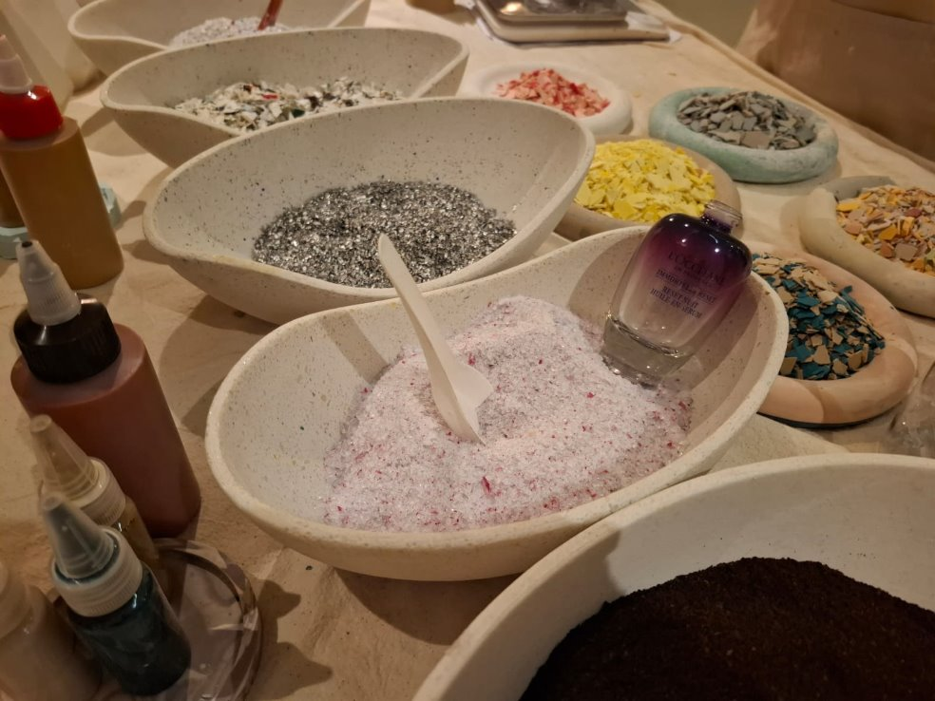
Objectives
Waste
Reborn
  Upcycle materials into aesthetically valuable products
  Introduce upcycled products as educational tools in schools
  Expand recycling points to include property management facilities
  Encourage collaboration with other Rotary Clubs

Slide 3
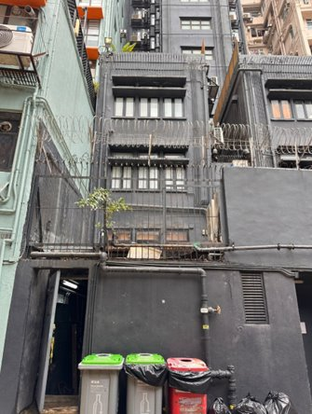
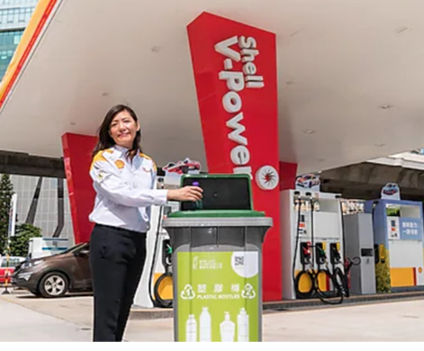
Why Partner with Crown Gas Stoves
  Established in 1979 with a long-standing history
  Strong and efficient logistics team
  Multiple recycling points, including:
  Retail stores
  Distributors
  Shell and Sinopec Gas Stations
Crown Gas Stoves (Holdings) Company Limited

Slide 4

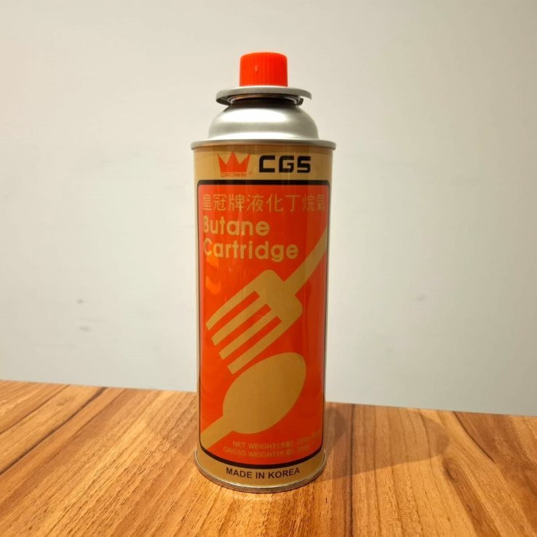
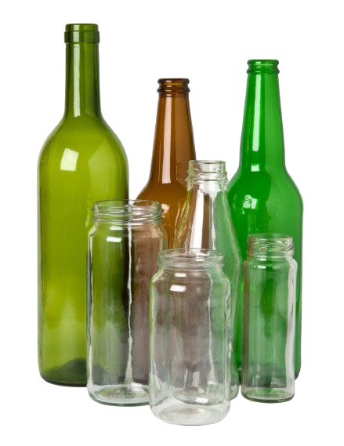
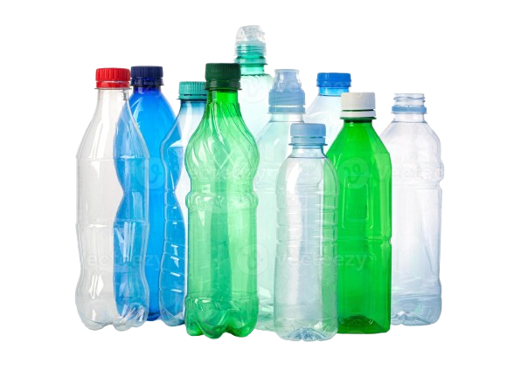
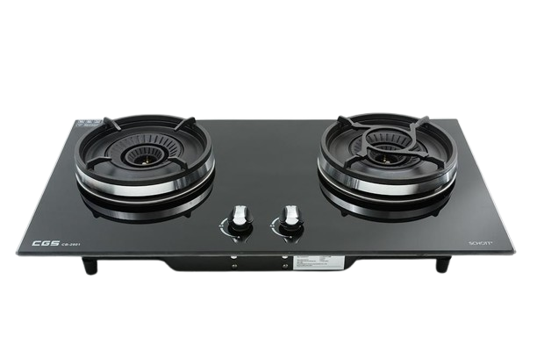

Recycling Materials
  Butane Cartridges (for hotpot use)
  Gas Stoves
  Glass Bottles
  Plastic Bottles
  Coffee Grounds

Slide 5

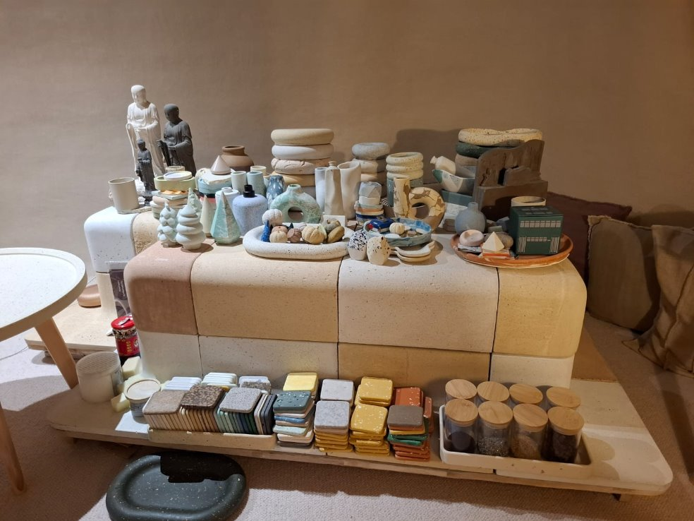
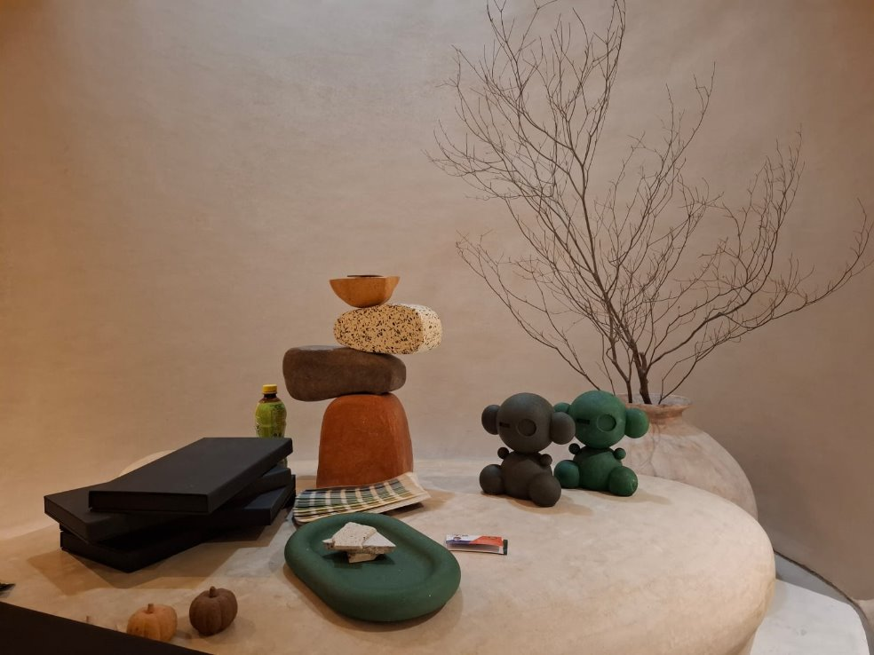
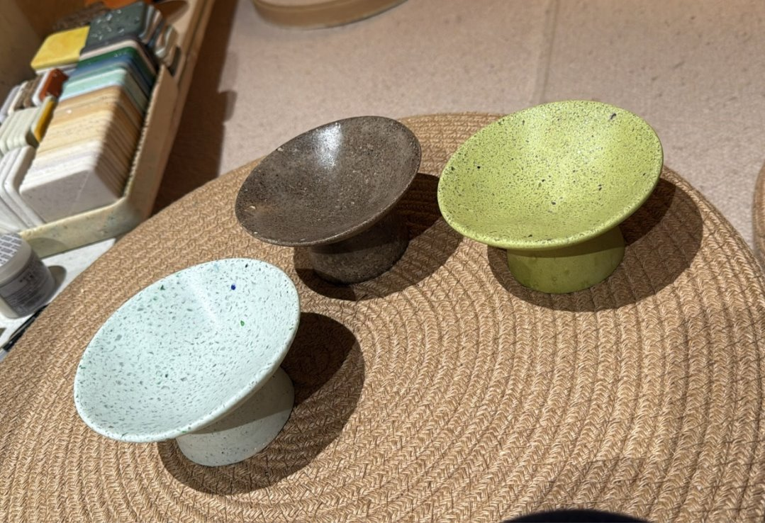
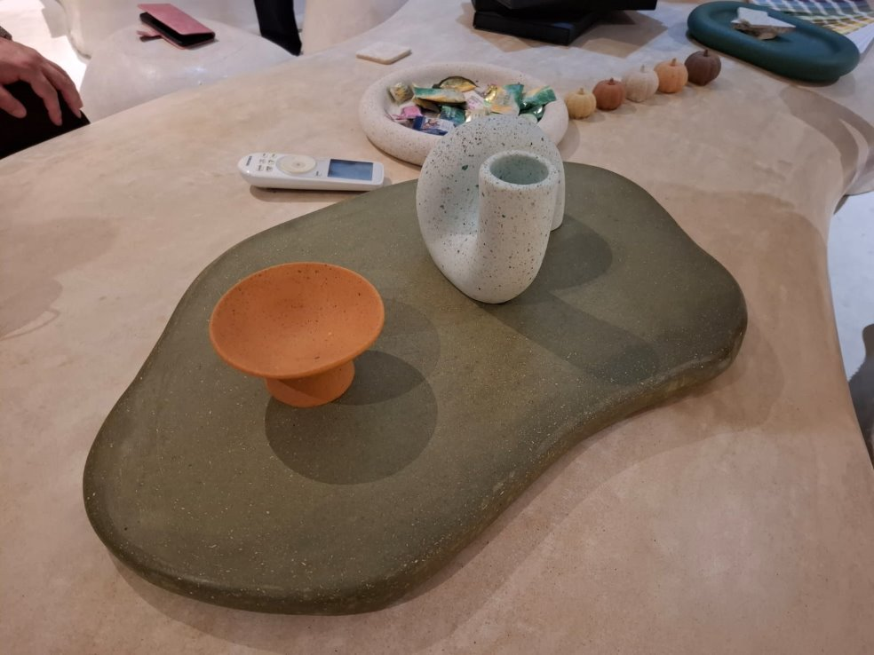
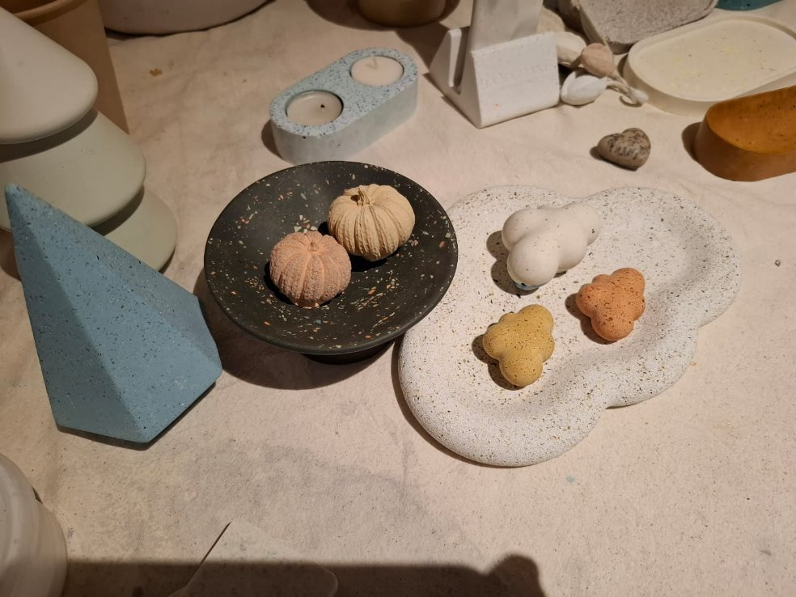
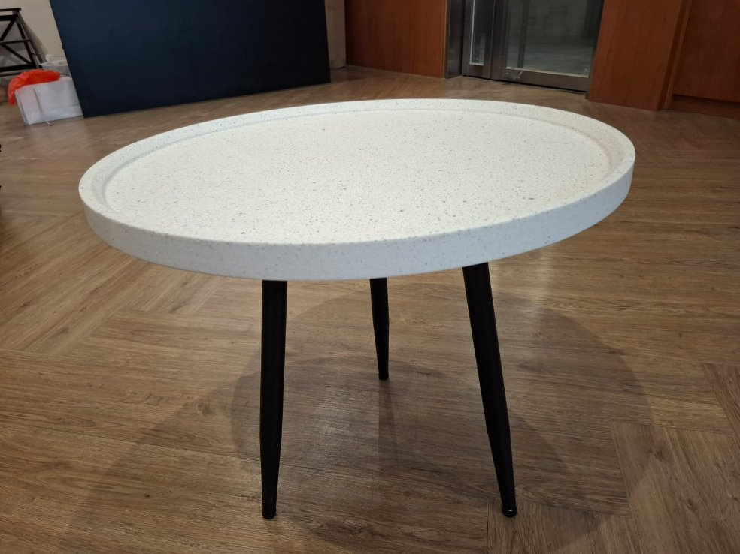
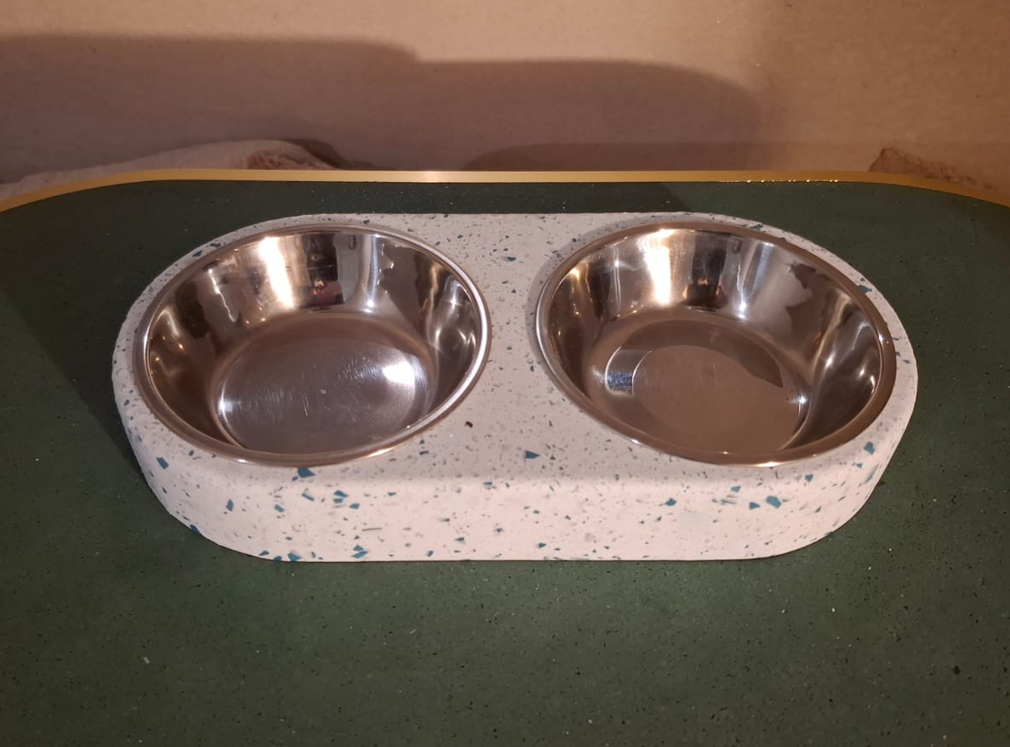
Aesthetic Sustainability
  Combining aesthetics with functionality
  Pet Supplies & Artistic Items
ECO
TRANSFORMATION

Slide 6


